Slide 1

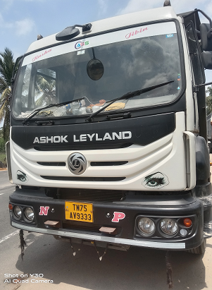
16 TG to 18 TG RA1 casing replacement
Veh no | TN75AV9333
VIN | MB1JJLHD8NRFZ9061
Eng no | NFHZ420582
CBN / Model | CTU352022B0005 / UJ3520/52 T TIP
LR Category | L3R2
Hrs Covered | 3,699 Hrs
DOF | 08.06.2023
DOS | 23.08.2022
Customer | Mr R.BABU
Complaint Reptd | Ra1 Housing oil Leak
Failure Observed | housing cracked @ 4 o'clock position in LHS Curved area,
Action Taken | Replaced to be new in 18TG Rear Axle Housing
iAlert observation | NA
Error code details | NA
Vehicle condition | Empty
Vehicle Application | Construction Material
Failure Location | Nagercoil .

Slide 2
Vehicle reported to workshop for Axle Housing Oil leak complaint
Driver and customer Voice:
Vehicle plying between Kavalkinaru to tirunelvelli local with one side load
Lead Distance: 100 Kms
Application: Blue metal
GVW: 43 T
Payload: 30 T
Rare : 13 T
As per CBN LR category is L2R3 and customer operating under L3R2

Slide 3
Service History :
Checked the service history, found there is no earlier attention for RA1 axle casing replacement
Job card number | Date | Customer Number | Name | Customer Voice | KM/HR Reading | Item Category | Labour value/part code | Labour Value/Part description | Quantity | Plant name
2019331891 | 02/06/2023 | 0011584865 | R.BABU | 10th leaf campaign work | 3,019.000 | P002 | P9F00604 | Tenth leaf-FTW00199 | 4.000 | TVS Mob.-Nagerkoil
2018805318 | 22/04/2023 | 0011584865 | R.BABU | 3000 KM SERVICE, COOLANT LEAK FROM HEAD, GEAR BOX OIL LEAK | 3,000.000 | P002 | EN699991 | Gulf Super Fleet ULE Dura Max | 18.500 | TVS Mob.-Trivandrum
2017864642 | 07/02/2023 | 0011584865 | R.BABU | 1500HRS SERVICE, ALL OIL CHANGE, CROSS BAR BOLT CHANGE, ADBLUE SUPPLY 2NOS. | 1,552.000 | P002 | GB699991 | Gulf Gear ED Dura Max 80W-90 | 34.000 | TVS Mob.-Trivandrum
2017864642 | 07/02/2023 | 0011584865 | R.BABU | 1500HRS SERVICE, ALL OIL CHANGE, CROSS BAR BOLT CHANGE, ADBLUE SUPPLY 2NOS. | 1,552.000 | P002 | EN699991 | Gulf Super Fleet ULE Dura Max | 18.500 | TVS Mob.-Trivandrum
2017864642 | 07/02/2023 | 0011584865 | R.BABU | 1500HRS SERVICE, ALL OIL CHANGE, CROSS BAR BOLT CHANGE, ADBLUE SUPPLY 2NOS. | 1,552.000 | P001 | FS0503 | 3st Free Service | 1.000 | TVS Mob.-Trivandrum
2016808074 | 11/11/2022 | 0011584865 | R.BABU | 1000hrs service / adblue : 89% | 1,056.000 | P001 | FS0502 | 2st Free Service | 1.000 | TVS Mob.-Nagerkoil
2016808074 | 11/11/2022 | 0011584865 | R.BABU | 1000hrs service / adblue : 89% | 1,056.000 | P002 | EN699991 | Gulf Super Fleet ULE Dura Max | 18.000 | TVS Mob.-Nagerkoil
2016478060 | 12/10/2022 | 0011584865 | R.BABU | 1st free service / ra1 crown fitting oil leak | 540.000 | P001 | FS0501 | 1st Free Service | 1.000 | TVS Mob.-Nagerkoil
2016478060 | 12/10/2022 | 0011584865 | R.BABU | 1st free service / ra1 crown fitting oil leak | 540.000 | P001 | RAX110Z | R & R Diff Assy-NGC | 1.000 | TVS Mob.-Nagerkoil
2016478060 | 12/10/2022 | 0011584865 | R.BABU | 1st free service / ra1 crown fitting oil leak | 540.000 | P002 | FYR01500 | WASHERSPECIAL M16 NORD LOCK | 14.000 | TVS Mob.-Nagerkoil
2015933045 | 25/08/2022 | 0011584865 | R.BABU |  | 5.000 | P001 | FS0001 | PDI SERVICE | 1.000 | TVS Mob.-Tirunelveli

Slide 4
Visual Inspection:
External Symptoms:-
No External Damage / impact on the vehicle
Rear Axle oil level checked found total 34 litters for both axle
Rear Oil condition, Quality found ok
Crown fitting bolt tighten found ok
Housing Breather condition found ok
Pinion Yoke Nut tighten checked found ok
Crown Wheel Stopper check nut, condition found ok
V rod and radius rod bush found ok
Maximum Load carrying of vehicle 25 ton
found Load Body extension up to 1 feet
Found there is 10th leaf spring addition work completed in this vehicle

Slide 5
Internal Symptoms:-
We investigated and noticed that an oil leak from RA1 housing cracked @ 4 o'clock position in LHS Curved area,
Found RA1 Axle Housing drive head mounting bolts are intact
Found RA2 Housing Tube Condition good
Found RA2 drive head mounting bolts were intact.
Found Radius rod bush condition good.
Found there is no leaf spring addition in suspension
Removed the U Clamp, Noticed casing top and bottom bracket condition is good.
Noticed RHS , LHS top bracket mounting bolts are intact.
Found trunnion shaft condition ok.
Found there is no external damage on suspension.
Found bogie bracket condition is good.
Removed the axle shaft and differential assembly.
Found differential components are good.

Slide 6
Rear Axle Specification/ sl.no:
Vehicle Model:
Rear Axle Make : Meritor / 16 TG
Meritor half axle no : XEV52700
Housing Tube Serial No : MB1315NK790617 / MA22O055332
Drive Head assy Serial No : AL13200K263617 / MD22G073681
CWP Match No : 22C112
Axle Ratio: 6.17
Md By: Automotive Axles Limited

Slide 7
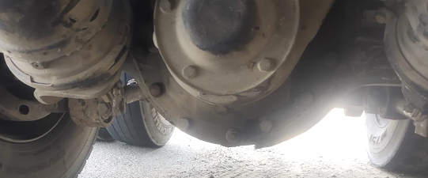
Found RA1 casing cracked @ 4 o clock position in LHS Curved area and consequential to oil leak

Slide 8
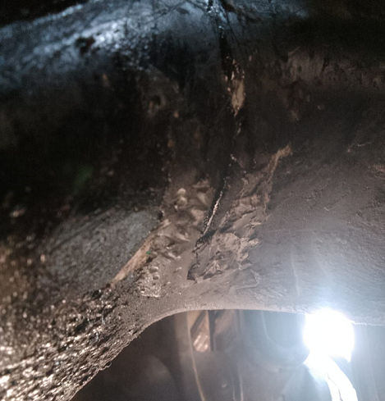
Found RA1 casing cracked @ 4 o clock position in LHS Curved area and consequential to oil leak

Slide 9
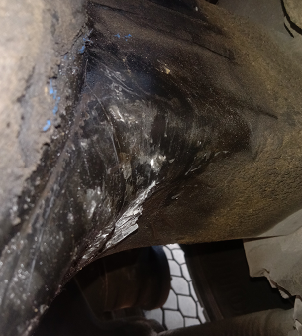
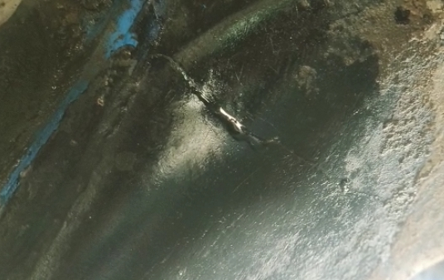
Found RA1 casing cracked @ 4 o clock position in LHS Curved area and consequential to oil leak

Slide 10
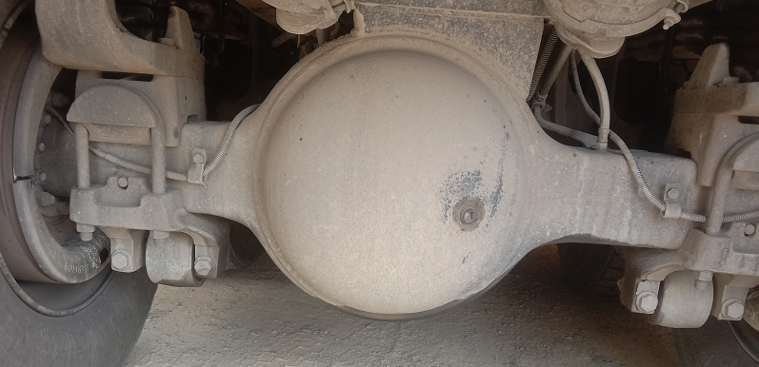
Found RA2 Housing Tube Condition good

Slide 11
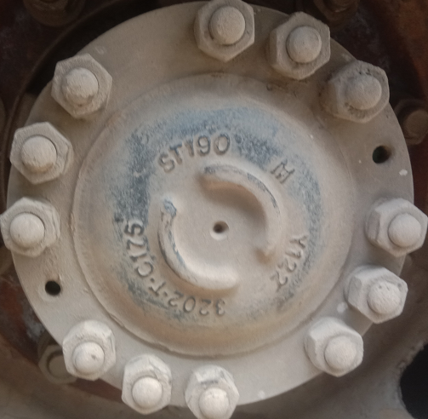
Ra1 axle shaft Serial No : ST190 M Y122

Slide 12
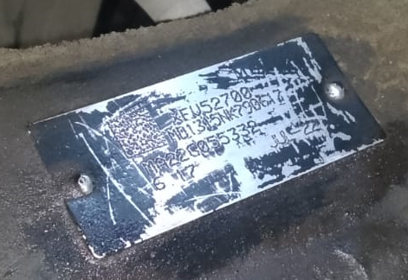
Housing Tube Serial No : MB1315NK790617 / MA22O055332

Slide 13
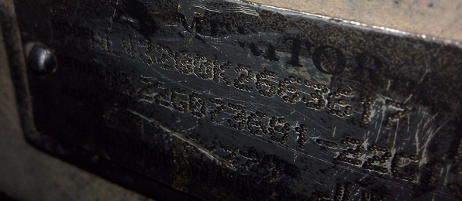
Drive Head assy Serial No : AL13200K263617 / MD22G073681

Slide 14
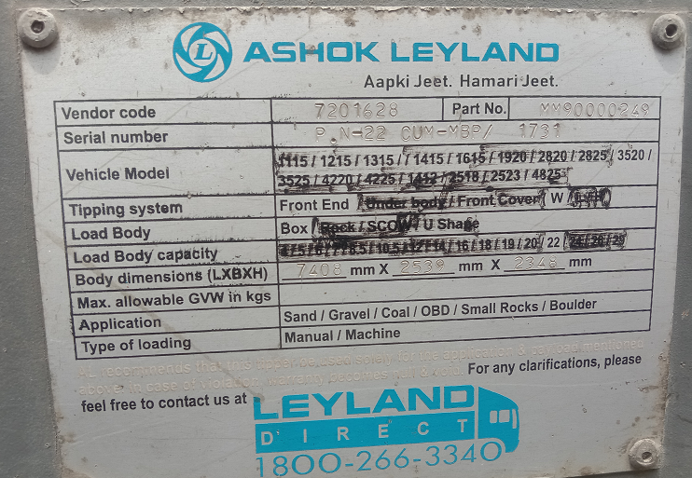
Vehicle Load Body serial No : P.N-22 CUM-MBP / 1731

Slide 15
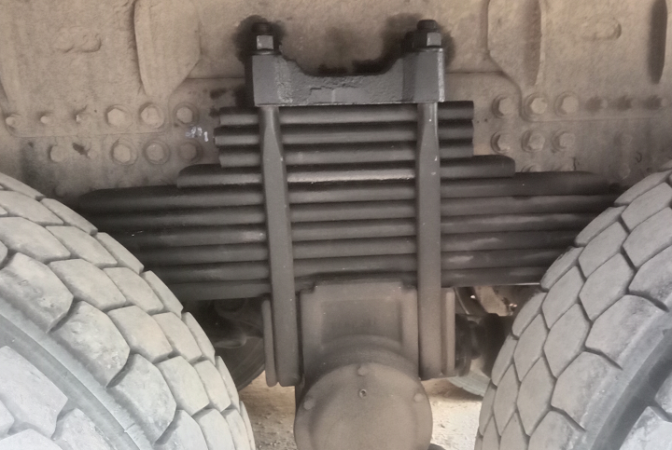
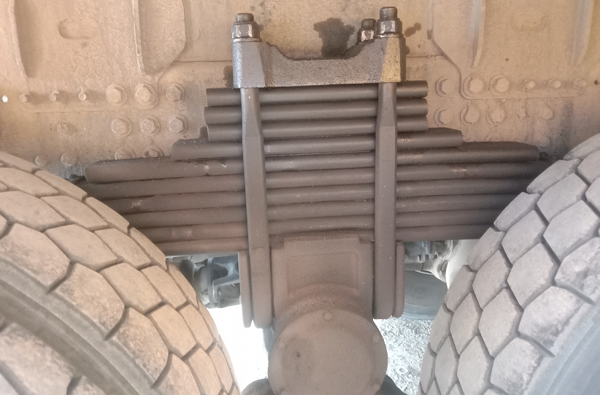
Found there is 10th leaf spring addition work completed in this vehicle

Slide 16
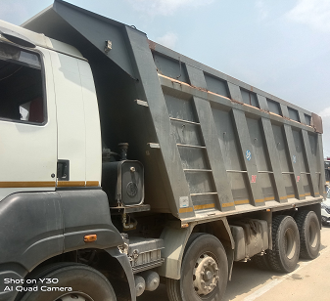
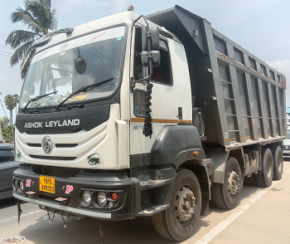
found Load Body extension up to 1 feet

